Slide 1
Perusall app: socially engaged reading and discussion in online courses
Dr. Dan Reynolds
Department of Education & School Psychology

Slide 2
Students read outside class?
Teacher frustrated…
Students frustrated…

Slide 3
Teacher problems
Some don’t read
Focus
Equity
Dialogue
Moderation
Preparation
Discussions don’t stick to text
Discussions dominated by a few
Students don’t respond to each other
Hard to monitor and grade online contributions

Slide 4
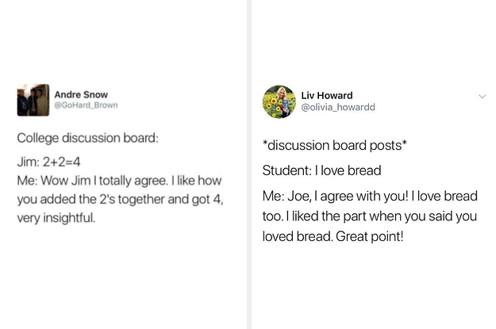
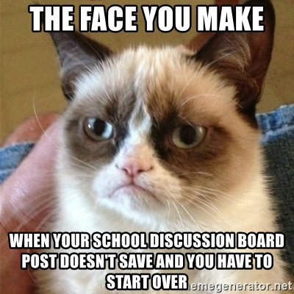
Hate canvas discussion boards?

Slide 5
solution
An app that integrates directly into Canvas. Allows students to collaboratively
Annotate PDF readings of all kinds.

Slide 6
solution
All required to read
Focus
Equity
Dialogue
Moderation
Preparation
Discussions directly on top of text
All students participate
Students easily respond to each other w/ hashtags
Autograded

Slide 7
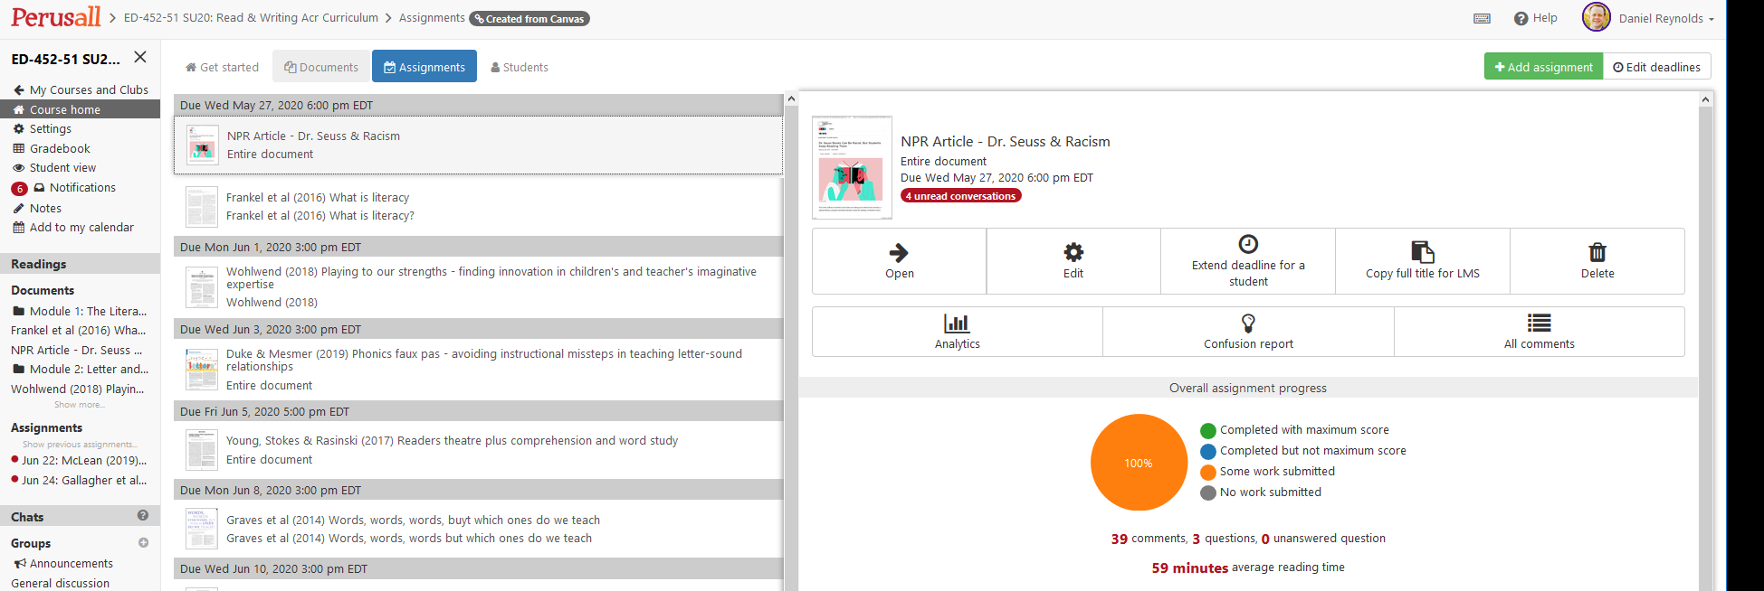
What does the app look like?
See my example from my summer ED 452: Literacy Across the Curriculum

Slide 8
LMS integrations
Blackboard
Moodle
Canvas
Brightspace
Sakai
Schoology

Slide 9
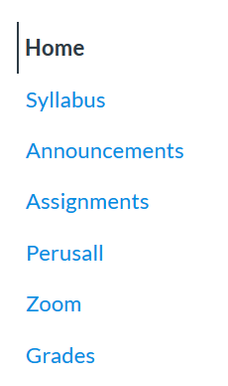
how does it integrate into an LMS?
Perusall publishes LMS-Specific Guide
Does take a little while – not automatic but it’s worth it
Only have to set it up once
Email support@perusall.com to verify your ID and you’ll get the “Consumer Key” needed to integrate to your LMS
Build LMS assignments with matching name to Perusall assignments to use the autograde feature
Be sure to review Perusall’s rubric and instructions for students so they know what they have to do to get a perfect score

Slide 10
Possible uses
Instruction
Teacher PD
For kids old enough to use it
Ongoing discussion of a book or set of journal articles
Enrichment
Book clubs?
School-wide and district-wide?

Slide 11
Instructional uses
Textbook reading
Supplementary articles
Research teams
Weekly current events articles
Poetry reactions

Slide 12
Tips to use
Invest your time in the tech setup
Link it to your gradebook, figure out how to use it yourself.
It’s intuitive, but there is a learning curve
Invest your kids’/teachers’ time in learning the platform
It’s intuitive, but there is a learning curve
Do it live in person so you can troubleshoot with them the first few days
Discuss the rubric with them
Invest your class time in making the practice socially engaged
Follow up on comments made outside of class
Show them how to use hashtags, memes, links, etc.
Scaffold the move between preparation for discussion and the actual discussion

Slide 13
Conclusions
Traditional
Individuals reading alone
Uncertain preparation, focus, and dialogue
Perusall
Social reading builds class community
Clear preparation, focus, and dialogue
Discussions dominated by a few
Everyone participates

