Slide 1
How and why we’ll use the perusall app
Dr. Dan Reynolds’ courses
Fall 2020

Slide 2
Ever had these problems?
Read for class, but didn’t understand?
No one to help while reading?
Classmates dominate in-class discussions?
Assigned reading not discussed?
Discussion goes off topic?

Slide 3
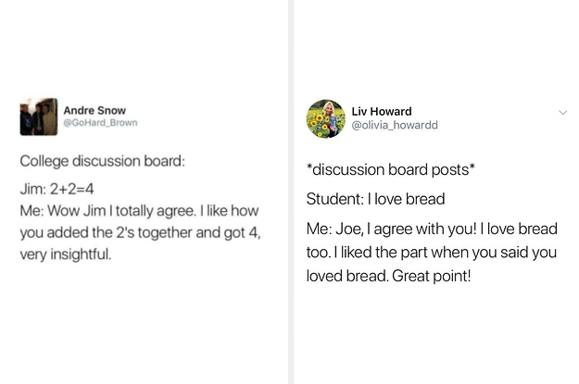
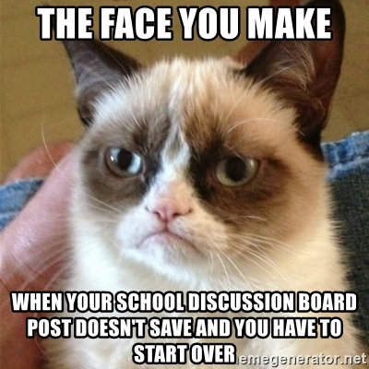
Hate canvas discussion boards?

Slide 4
Prof struggles = student struggles

Slide 5
solution
An app that integrates directly into Canvas that allows students and the professor to collaboratively annotate PDF readings of all kinds.

Slide 6
how does it work?
1. Go to the Perusall app in Canvas
2. As you’re reading the article, write annotations, ask questions, respond to classmates, give upvotes
Perusall Rubric posted to Canvas will give you a grade from 0-3 on each reading
Due dates listed both in Canvas and Perusall

Slide 7
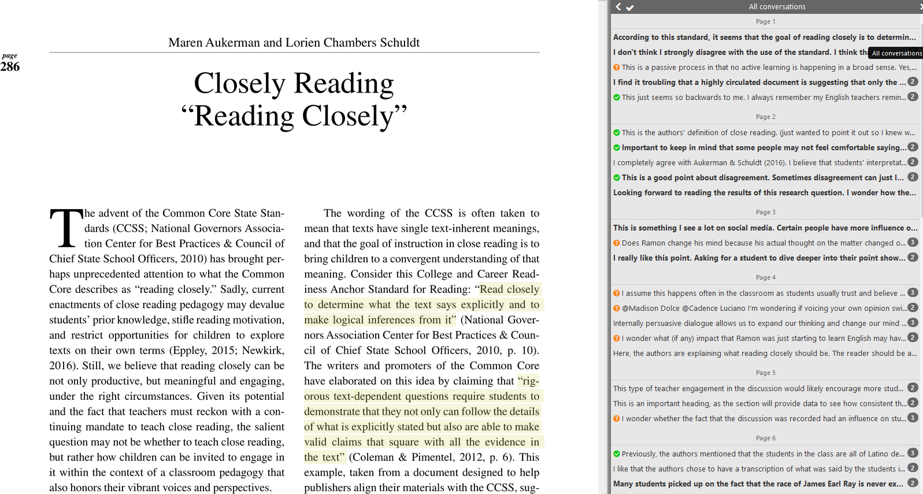
What does it look like?
Article on PDF
Sidebar conversation
threads
Highlighted parts showing where the conversation is happening

Slide 8
Perusall tactics
Use @Names to directly pose questions or comments to each other
Upvote others’ points (so you don’t need to say “Me too!”)
Use #hashtags to connect ideas across readings and classes all semester
General Goal:
Quality > quantity, though.
Cover the whole reading – 8 comments on p. 1 is bad. Read the whole thing!
Perusall scores your questions, your upvotes, your thoroughness, and your quality (and we review Perusall’s scores)

Slide 9
Conclusions
Traditional reading
Individuals reading alone
Uncertain preparation, focus, and dialogue
Perusall reading
Social reading builds class community
Clear preparation, focus, and dialogue
Not integrated into Canvas
Built seamlessly into Canvas

Slide 10
Let’s take a tour!

